Slide 1








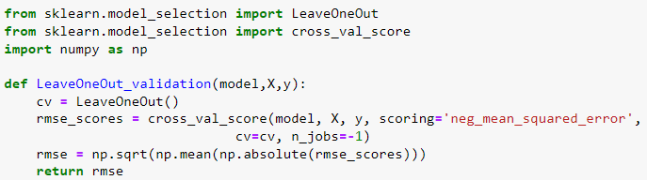
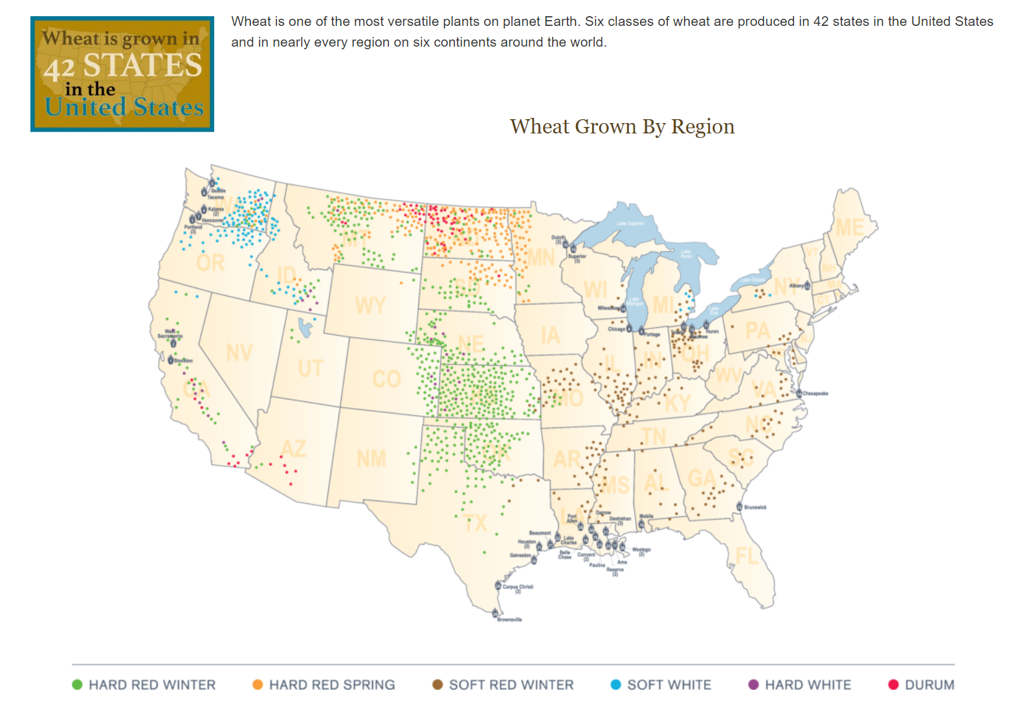

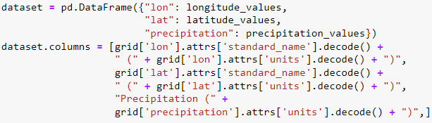
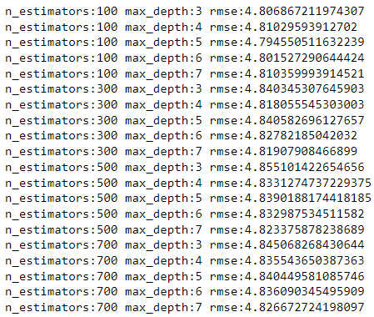
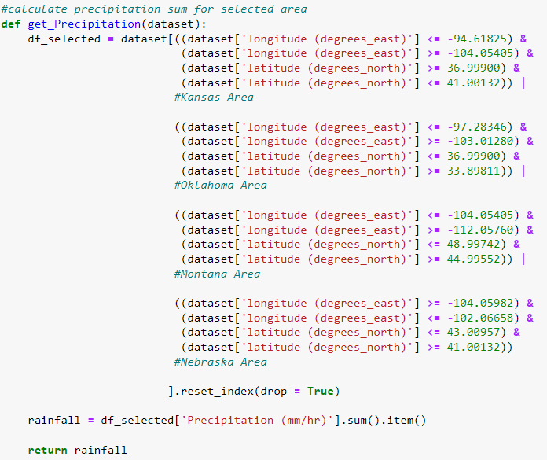

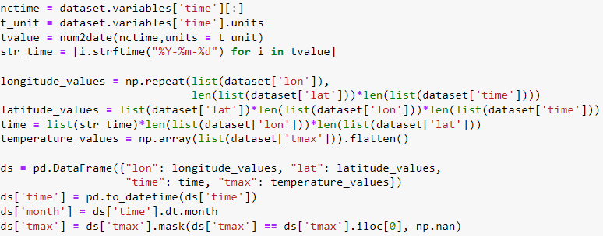
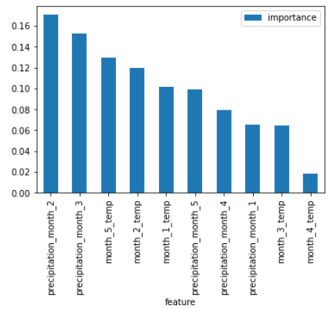
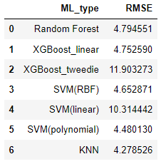

The Analysis Pipeline: Data Processing and
Ziqian Zhang, zhangz46@rpi.edu
Rensselaer Polytechnic Institute, Troy, NY, United States
Abstract
Data Processing and Modeling
Hard red winter wheat is the most common variation of wheat grown in the United States. It’s a versatile wheat which mostly used for bread, hard rolls, flat breads, all-purpose flour, and Asian style noodles. In this study, I investigate how precipitation and temperature influence hard red winter wheat yield. Leveraging different types of regression model to predict the annual wheat yield based on precipitation and temperature data from 2001 to 2021. The result shows that K-Nearest Neighbors Regression and Support Vector Regression with polynomial kernel achieve the best performance with RMSE value of 4.279 and 4.480 using leave one out cross validation.
This poster will mainly focus on data processing and modeling. The objective is to present an overview of the report of this study.
Data processing
Modeling
Import
From HDF5 files
From netCDF files
Explore
Explore N-dimension dataset
Find out our target data features
Process
Fill missing value or adjust bias
From excel spreadsheet file
Save the dataset to csv format
Data munging
Add unit value on column name
Model type
Determine choose what type of model
Use sklearn package
Validate
Choose validation approach
Interpret
Feature importance analysis
Model performance comparison
Select validation metrics
Model tuning
1. Import data:
Python
A. HDF5 files
B. netCDF data files
2. Explore data:
3. Process data:
A. HDF5 files
B. netCDF files
1. Model type selection:
The target variable is continuous variable, so choose regression type model.
select model type:
XGBoost regression
Random Forest regression
Support Vector regression
KNN regression
2. Model validation:
Use leave one out cross validation.
Reason: 1. small dataset 2. prevent overfitting
Use RMSE as model validation metrics.
Lower RMSE value means better model performance.
Model tuning based on RMSE metrics and leave one out cross validation. Take random forest as example.
3. Model result interpretation:
feature importance and model comparison
Motivation
It is not easy for student to deal with high-dimension dataset and how to use those data to address practical problem.
Hope this presentation could serve as a cheatsheet for data processing and modeling in terms of resolving practical problem.
Select Target Area
Observe wheat map.
Use grid to best include green point
Get approximate location from google map
Sponsors:
Glossary:
Python – A programming language, capable of processing data/statistical analysis
Package: Software package to be loaded to perform extra tasks
Pandas, Numpy – Useful data manipulation packages in python
Dataframe – Data manipulation structure python pandas
netCDF4, h5py – Packages used to import and transform netCDF and HDF5 file in python
Sklearn – Package contains multiple machine learning model.
Dataset Resources:
Huffman, G.J., E.F. Stocker, D.T. Bolvin, E.J. Nelkin, Jackson Tan (2019), GPM IMERG Final Precipitation L3 1 month 0.1 degree x 0.1 degree V06, Greenbelt, MD, Goddard Earth Sciences Data and Information Services Center (GES DISC), 10.5067/GPM/IMERG/3B-MONTH/06
CPC Global Temperature data provided by the NOAA/OAR/ESRL PSL, Boulder, Colorado, USA. https://downloads.psl.noaa.gov/Datasets/cpc_global_temp/

